Slide 1
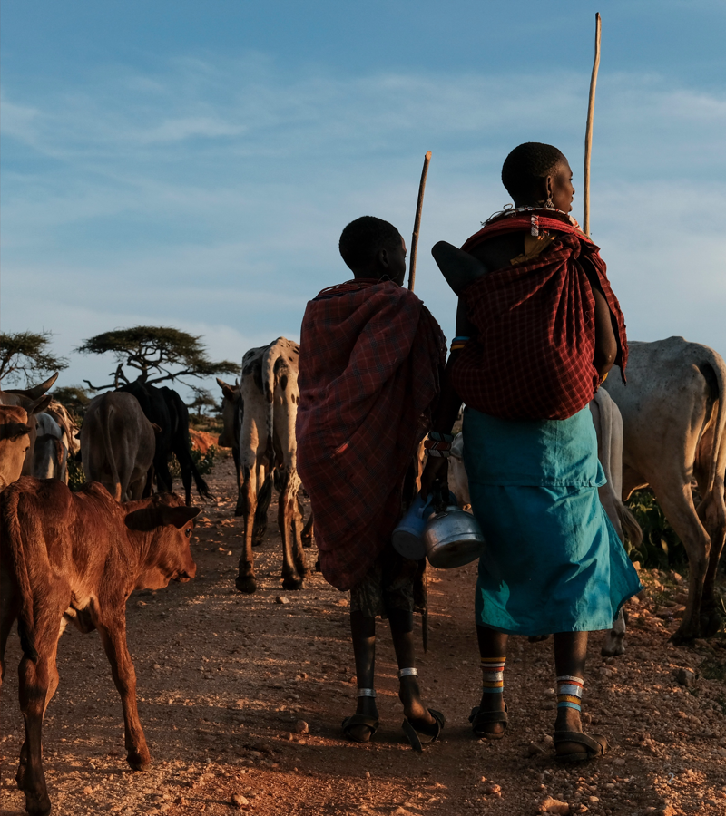

What is on the surface?
MODULE 7 · DAY 8 MORNING
Capsule and O-antigen typing with Kaptive, and what serotypes do and do not tell us about treatment
Neonatal AMR genomic surveillance of K. pneumoniae and E. coli
KlebGen training · Africa CDC and ILRI
Module 7 · Capsule, O antigen and vaccines | Day 8
Notes:
Day 8 morning. Everything so far has been about the inside of the cell: which genes it carries, where they sit, how lineages are related. This morning we look at the outside, at the two sugar coats a vaccine or an antibody would have to recognise. Two warnings up front, because trainees often expect the opposite. First, serotype does not tell you which antibiotic to give; AST does. Second, the honest value of this typing is at population level, for vaccine design and surveillance, not at the bedside. We will be explicit about both.

Slide 2

Day 8 at a glance
Session | Time | Topic | Module
1 | 09:00–10:30 | Capsule (K) and O-antigen typing with Kaptive | 7
2 | 11:00–12:30 | What would a vaccine cover? | 7
3 | 13:30–15:00 | One table for everything: joining results in R | 8
4 | 15:30–17:00 | Checking the joined table; summary statistics | 8
You will produce
K and O calls for all 29 isolates compared with the published typing, and a vaccine-coverage figure
Module 7 · Capsule, O antigen and vaccines | Day 8
2
Notes:
These slides cover the morning only: Module 7, the two antigen sessions. The afternoon (shaded rows) starts Module 8, joining every result table into one row per isolate, which has its own slides. Module 7 is short on tool work and long on interpretation, so expect more discussion than typing today.

Slide 3
By the end of this morning you can
Name things correctly
Run and judge Kaptive 3
Explain K-locus (KL) and O-locus (OL) nomenclature, and the difference between a locus and a predicted type.
Type K and O loci, read the Match confidence and Problems columns, and say when not to trust a call.
Answer the clinical question honestly
Calculate vaccine coverage
Say what a serotype does and does not change for the baby in front of you, and where it changes management instead.
Work out what a multivalent vaccine would cover, and explain how sampling, place and time move that number.
Module 7 · Capsule, O antigen and vaccines | Day 8
3
Notes:
The third objective is the one trainees most often arrive with the wrong expectation about. Many assume that because serotyping guides therapy in some other infections, it must do so here. It does not. Say so early, then spend the second session on where the typing genuinely earns its place.

Slide 4

Typing the sugar coats
SESSION 1 · 09:00–10:30 · MODULE 7
Capsule (K) and O antigen, and how Kaptive 3 calls them
Module 7 · Capsule, O antigen and vaccines | Day 8
4
Notes:
Session 1 is the mechanics: what the two polysaccharides are, how they are named, how Kaptive finds them, and why the K locus in particular is hard to get right from short reads. Keep the vaccine arithmetic for session 2 so that trainees first learn to distrust a bad call before they start counting them.

Slide 5
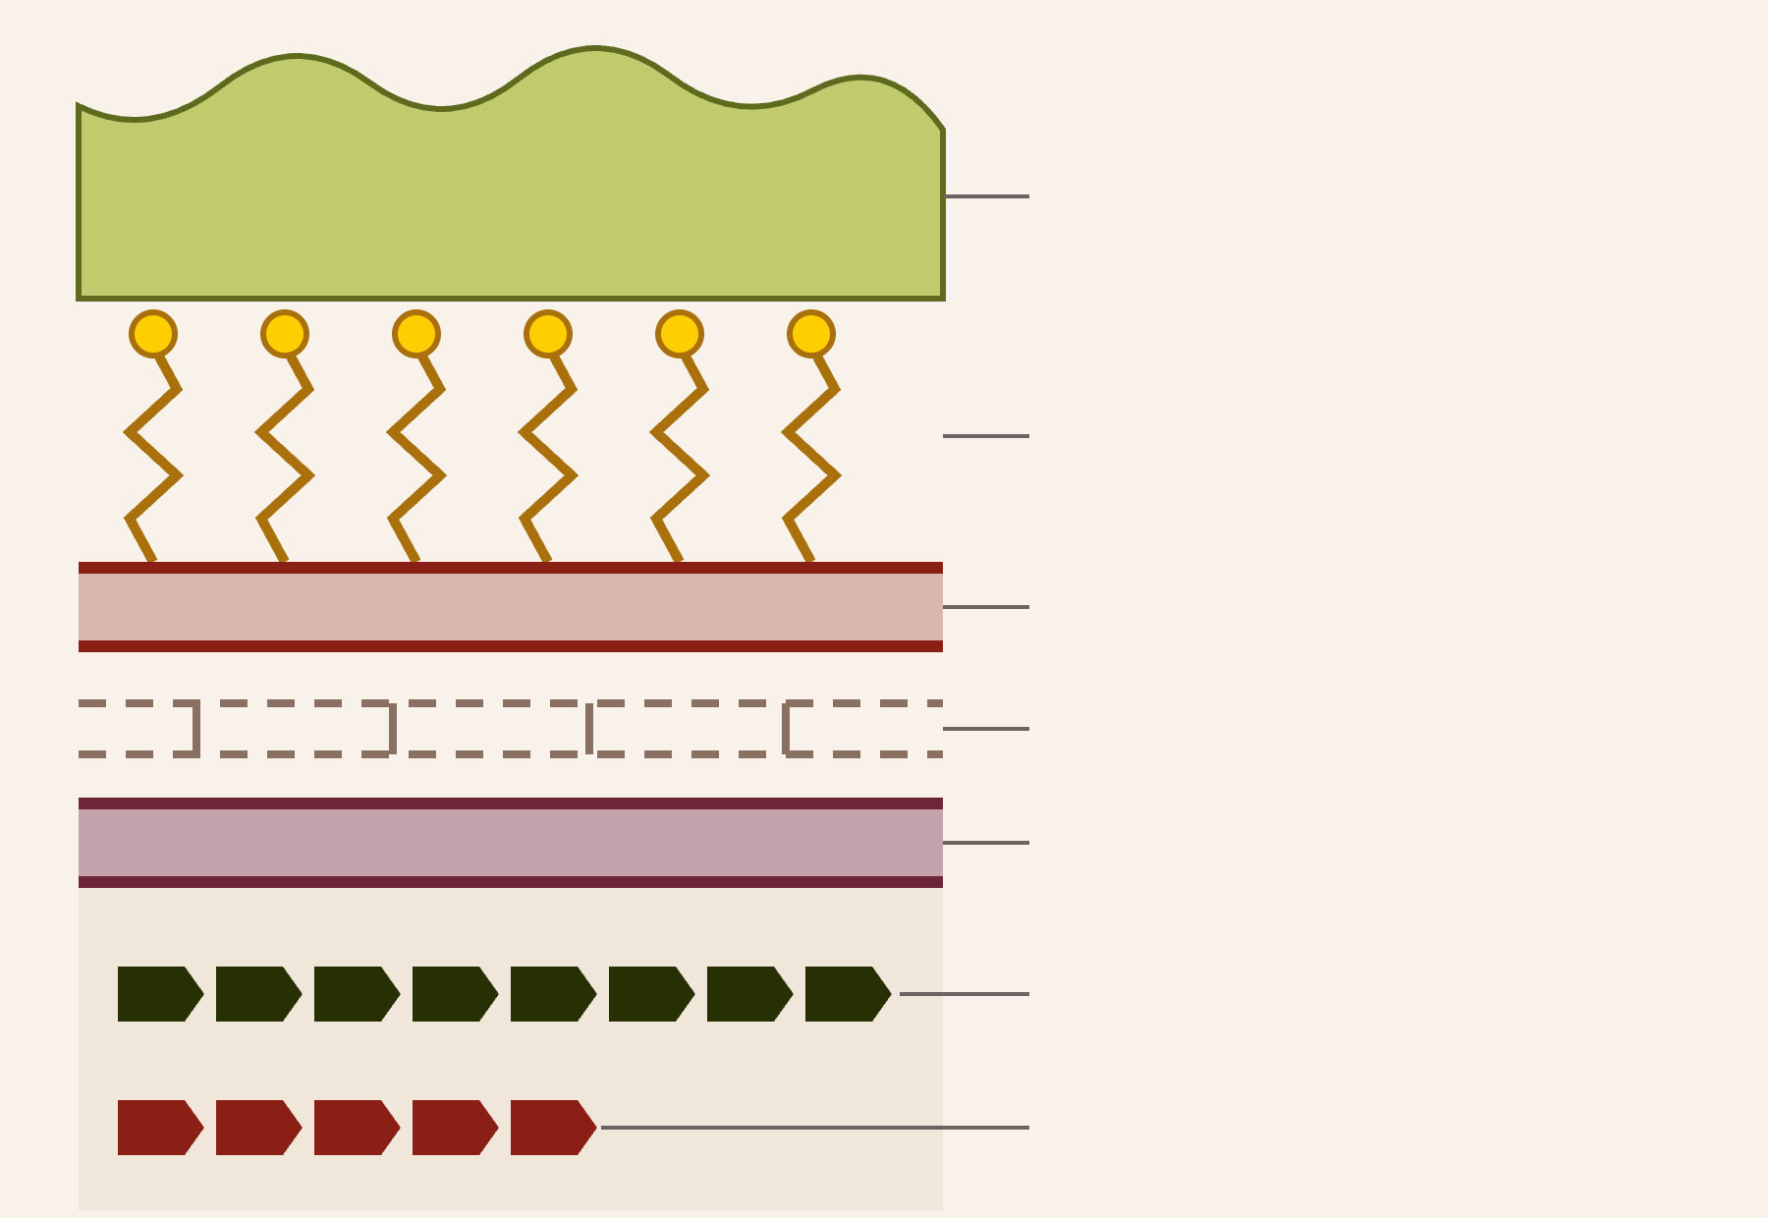
Two sugar coats on the outside
The capsule is the thick outer coat
Capsule — K antigen
It hides the cell from complement and phagocytes, and it is the first thing an antibody meets. It is also by far the more diverse of the two.
O antigen (outer part of LPS)
The O antigen is part of LPS
The repeating sugar chain on the outer end of lipopolysaccharide. Shorter than the capsule, and only about a dozen types across the whole species complex.
Outer membrane
Peptidoglycan, periplasm
Inner membrane
Each coat is built by one gene cluster
The K locus sits between galF and ugd; the O locus is the rfb cluster. Kaptive types the gene cluster, not the sugar.
K locus (KL) on the chromosome
O locus (OL), the rfb cluster
Why we care today
Both are candidate targets for a maternal vaccine against neonatal sepsis, and the choice between them is a diversity problem.
Module 7 · Capsule, O antigen and vaccines | Day 8
5
Notes:
Work from the outside in. The capsule is the thick outer layer, so it is the most accessible target for antibody, but it is also the most variable: well over a hundred capsule loci are described. The O antigen is underneath it, on LPS, and is far less diverse. Both are encoded by a single cluster of genes on the chromosome, which is what makes in silico typing possible at all: you find the cluster and read off which one it is. Note the last point on the diagram, because the locus-versus-type slide depends on it: the tool tells you which gene cluster is present, which is not quite the same as telling you which sugar is on the surface.

Slide 6
Both coats exist to evade immunity
The capsule does most of the work
The O antigen, more narrowly
Resists phagocytosis
Long O chains hold the membrane attack complex at a distance — the classic serum resistance mechanism — and the chain is strongly immunogenic in its own right.
A hydrated, negatively charged surface that phagocyte receptors cannot get hold of.
Blocks complement
The inflammatory storm of Gram-negative sepsis comes from lipid A beneath it, not from the O antigen.
Keeps C3b from depositing on the surface, or hides it from receptors, and holds the membrane attack complex away from the outer membrane.
Masks what lies beneath
Why this makes them targets
Outer membrane proteins — and the O antigen itself — are hidden from antibody.
Abundant, surface-exposed, and already what the immune system is trying to attack. That is the definition of a good vaccine antigen.
Buffers antimicrobial peptides
Defensins and LL-37 are trapped before they reach the membrane. In hypervirulent strains rmpADC thickens the capsule further.
But note the geometry
The capsule covers the O antigen. Hold on to that — it is the central difficulty for an O-antigen vaccine.
Module 7 · Capsule, O antigen and vaccines | Day 8
6
Notes:
This slide answers the question trainees ask as soon as they see the diagram: why does the organism bother with two sugar coats? Because each one is a defence against a different arm of innate immunity. The capsule is the general-purpose shield and the reason an unencapsulated mutant is almost avirulent. Draw out the third bullet in particular, because it sets up the tension we return to before the coverage arithmetic: the capsule hides the O antigen, so an antibody raised against the O antigen has to reach through the capsule to do anything. Keep the lipid A point clear as well, since trainees routinely conflate endotoxin with the O antigen; they are parts of the same molecule but only lipid A drives the TLR4 response.

Slide 7
K and O side by side
 | Capsule (K antigen) | O antigen (LPS)
Diversity | High: well over 100 known K loci | Low: about a dozen types
Locus name | KL1, KL2, KL107 … | O1/O2v1, O3b, OL101 …
Predicted type | K1, K2 … or unknown | O1, O2, O3b, O4, O5 …
Assembly from short reads | Harder: lower GC than the rest of the genome, so coverage dips and the locus breaks across contigs | Easier: shorter and usually in one piece
Vaccine implication | Needs many valencies to cover a population | A few valencies can cover most strains
Watch the string matching
Both coats, one isolate
O12 is not an O1. Grouping O types with starts with “O1” silently swallows O12 and inflates your coverage figure. Group O1a, O1b and O1 explicitly.
Every isolate has a K type and an O type, and they vary independently. Our ST39 cluster is KL2 with O1b; other KL2 isolates carry other O types.
Module 7 · Capsule, O antigen and vaccines | Day 8
7
Notes:
The diversity difference is the single most important row in this table, and it drives the whole vaccine discussion in session 2: a capsule vaccine has to be very highly multivalent to be useful, an O-antigen vaccine does not. The GC row explains why the confidence column matters more for K than for O, and it is also why trainees often see a split K locus in a short-read assembly and an intact one in a hybrid assembly of the same isolate. The O12 warning looks pedantic but it is a real bug trainees hit in the R exercise, so flag it now rather than after they have computed the wrong number.

Slide 8
A locus is not a serotype
KL2 is a genotype
Genes outside the locus can change the type
“The gene cluster in this genome matches reference K locus 2.” That is a statement about DNA, and it is what Kaptive actually measures.
O1 and O2 are built from the same O locus. Which one appears on the surface depends on extra genes (wbbY, wbbZ) sitting elsewhere in the genome.
That is why Kaptive reports the locus as O1/O2v1 and then resolves the type separately.
K2 is a predicted phenotype
“That cluster is expected to make the K2 capsule, which antiserum would agglutinate.” An inference from the DNA, not a serological result.
And a broken gene can remove it
A truncated wcaJ or wbaP gives an acapsular cell: the locus is still KL-something, but there is no capsule on the surface. Kaptive 3 checks for this and updates the predicted type.
Hence “unknown” in the type column
Many K loci have never been matched to a named serotype. A confident KL107 call with an unknown type is a good result, not a failure.
Module 7 · Capsule, O antigen and vaccines | Day 8
8
Notes:
This is the slide that prevents most of the misreading later in the day. The KL prefix means locus and the bare K means the serotype predicted from it; the two columns in the output are not redundant. Trainees often treat an unknown type as a failed run and try to rescue it, so say explicitly that a confident locus with an unnamed type is a perfectly good result and should be reported as the locus. The O1 and O2 example is worth dwelling on: it is the cleanest demonstration that surface phenotype is not fully determined by the locus, and it also explains the odd-looking O1/O2v1 strings trainees will see in their own output in about twenty minutes.

Slide 9
How Kaptive 3 makes a call
1 · Score every locus, gene by gene
2 · Align the top loci in full
minimap2 aligns the genes of every reference locus to the contigs. Scores are summed per locus and weighted by the proportion of that locus’s genes found, then the loci are ranked.
Only the top-ranked loci (two by default, --n-best) are aligned whole. Highest alignment score wins, and this step also gives the locus coordinates in the assembly.
3 · Annotate the genes inside
4 · Resolve the predicted type
Overlapping hits from other loci are dropped, the genes within the coordinates are translated and aligned to their reference proteins, and identity and coverage are reported per gene.
Known phenotype-changing genes outside the locus are checked, and the type is set from the intact gene content — so a truncated wcaJ yields an acapsular call.
Versus Kaptive 2
v2 aligned every locus with BLASTn and chose on overall coverage. v3 drops BLAST+ entirely, fully aligns only the best candidates, and runs about 18× faster on the KpSC K database (1.3 s versus 23.4 s per genome). Crucially, it also handles a locus split across contigs.
Module 7 · Capsule, O antigen and vaccines | Day 8
9
Notes:
The two-stage design is the point worth remembering: a cheap gene-level screen over the whole database, then an expensive full alignment of only the best two candidates. That is where the speed comes from, and it is also what lets the tool separate closely related loci that differ in only a gene or two. Step 4 is the one that connects back to the previous slide: the predicted type is assembled from gene content, including genes outside the locus, which is why it can differ from what the locus name alone would suggest. The fragmented-locus handling in v3 matters a great deal for us, because our short-read capsule loci are frequently in pieces.

Slide 10
Reading confidence and problems
Typeable
The Problems column
In one piece: no gene below the identity threshold, no missing genes, and no untruncated genes from other loci inside the region.
Symbol | What it reports
? | Match was in several pieces; the number after it is how many
− | Expected genes were not found
+ | Extra genes found inside the locus
* | Expected gene found, but below the identity threshold
! | One or more genes found but truncated
In several pieces: no gene below the threshold, missing genes within the limit (50% by default), and no more unexpected genes than the limit (1 by default).
Untypeable
Fails both sets of criteria. The documentation is blunt: do not accept these results unless you can go and look at the data yourself.
Two tiers, not six
A ?2 on a short-read capsule locus is routine and often harmless. A ! is the one to stop on: a truncated gene may be a real acapsular mutant, or just a contig break.
Kaptive 2’s six levels (Perfect, Very high, High, Good, Low, None) are gone. If you have older results or older papers to compare with, the confidence columns are not interchangeable.
Module 7 · Capsule, O antigen and vaccines | Day 8
10
Notes:
Make trainees read these two columns together, never the type alone. The confidence call tells you whether to believe the locus; the problems string tells you why the tool is worried. The distinction that matters most in practice is between a fragmented but otherwise complete locus, which is usually fine, and a truncated gene, which is ambiguous between biology and assembly error. The only way to settle a truncation is to look: check the contig ends, and if an isolate matters, sequence it long-read. Note the version warning as well, since much of the published Klebsiella literature uses Kaptive 2's confidence tiers and trainees will be comparing their output against exactly those papers.

Slide 11
Hands-on: Kaptive on your isolates
use_tools typing
mkdir -p $RESULTS/07_antigens
# your practice isolates, K locus then O locus
practice=$(for s in $PRACTICE; do echo $COURSE/best/$s.fasta; done)
kaptive assembly kpsc_k $practice -o $RESULTS/07_antigens/kaptive_k_practice.tsv -t $THREADS
kaptive assembly kpsc_o $practice -o $RESULTS/07_antigens/kaptive_o_practice.tsv -t $THREADS
pick 'Best match locus|Best match type|Match confidence|Problems' $RESULTS/07_antigens/kaptive_k_practice.tsv
# the trainers' tables for all 29 isolates, used in session 2
use_precomputed 07_antigens
Then check your calls
Short read versus hybrid
Compare with published_K_locus and published_O_type in metadata_compact.tsv. Explain every disagreement.
Run the three hybrid isolates on both assemblies. Does the locus change, or only the confidence? Write down which.
Two databases, two runs. kpsc_k and kpsc_o are separate: the K and O calls come from separate commands and land in separate files. Joining them is your job, in session 2.
Module 7 · Capsule, O antigen and vaccines | Day 8
11
Notes:
Kaptive is fast, so everyone can run their own practice isolates in a couple of minutes; use_precomputed then brings in the full set of 29 for the vaccine arithmetic after the break. The hybrid comparison is the most instructive part of the session: in most cases the locus call is the same and only the confidence and the problems string improve, which is exactly the reassuring result trainees need before they trust short-read capsule typing at all. If an isolate's locus call actually changes between assemblies, that is worth five minutes of group discussion.

Slide 12
A lineage can change its coat
The K locus is a recombination hotspot. A clone can replace its whole capsule locus with another one and carry on, so capsule type and lineage are not locked together.
Do not type by lineage
You cannot infer the capsule from the ST, nor the ST from the capsule. Report what you measured.
In our own ST39 isolates
One sequence type, five capsule loci: KL2, KL23, KL51, KL62, KL149. The 2017 outbreak cluster is KL2; the 2016 isolate BKR8JH from the same nursery is KL23.
O is more stable
The O locus recombines far less, which is a second argument in its favour as a vaccine target.
Two consequences
Think back to Day 7
For the vaccine: a capsule vaccine targets the capsule, not the lineage, so a lineage can switch out from under it.
This is why the capsule difference in BKR8JH was only a prompt to look harder, and the SNP distance was the answer.
For the outbreak: a different K locus is a hint that two isolates are not the same recent strain — but it is a hint, not evidence. Settle it with SNPs.
Module 7 · Capsule, O antigen and vaccines | Day 8
12
Notes:
Capsule switching is the fact that ties this session to the vaccine arithmetic after the break, and it is also a direct callback to yesterday's outbreak work. Five capsule loci within one ST in a single hospital collection is a vivid local illustration; trainees can verify it themselves in the published typing column. Be careful to keep the outbreak inference honest: a different capsule raises a question, and only the core SNP distance answers it. Exactly the same logic runs the other way, which is why we never infer a capsule type from a sequence type even when the association in the literature looks strong.

Slide 13

So what is it good for?
SESSION 2 · 11:00–12:30 · MODULE 7
What serotype does not change, what it does change, and what a vaccine would cover
Module 7 · Capsule, O antigen and vaccines | Day 8
13
Notes:
Session 2 is the interpretation half. Start with the question trainees actually want answered, which is whether any of this changes how a baby is treated, give the honest answer, and only then show where the typing genuinely earns its keep. Ending the morning on the coverage arithmetic leaves them with something they can compute on their own country's data.

Slide 14
Does the serotype change which antibiotic we give?
THE QUESTION TRAINEES ALWAYS ASK
No.
The capsule and O antigen are not resistance mechanisms. No K or O type tells you whether an isolate carries blaCTX-M-15, a carbapenemase or an aminoglycoside-modifying enzyme. Susceptibility testing decides therapy.
The classic counter-example
Associations are not rules
What does decide
The hypervirulent K1 and K2 strains are typically antibiotic-susceptible. The multidrug-resistant lineages carry quite different capsule types.
Some capsule types do travel with resistant clones, because they travel with the lineage. That is epidemiology, and it is far too loose to treat a baby on.
AST first, and the resistance genes from Day 4 as a check on it. Never report a K or O type as a treatment recommendation.
Module 7 · Capsule, O antigen and vaccines | Day 8
14
Notes:
Say the No out loud and let it sit. Trainees arrive expecting serotyping to behave the way it does for pneumococcus or Salmonella, where a serotype genuinely steers management, and the analogy misleads them. The hypervirulent K1 and K2 example is the cleanest way to break it: the most dangerous capsule types in the literature are usually the ones that respond to ordinary antibiotics, while the hard-to-treat isolates in our own collection have unremarkable capsules. Do acknowledge the real associations rather than denying them, because trainees will find them in the literature and you lose credibility if you pretended there were none; the point is that a correlation mediated by clone is useless at the bedside. Then move straight on, because the next slide is where the typing pays off.

Slide 15
Where serotype does change things
Vaccines — the main reason we type
Monoclonal antibodies
A maternal vaccine has to match the antigens circulating where the mothers are. Serotype distributions are the design input, and they are what your surveillance contributes.
Antibody-based prophylaxis and therapy is antigen-specific in exactly the same way. Knowing the local O distribution says whether a given mAb could ever be relevant here.
Phage therapy
Surveillance and outbreaks
Most Klebsiella phages bind the capsule, and their depolymerases are K-type specific. So the K type genuinely predicts which phages could work — a live question for untreatable isolates.
A cheap extra marker that is independent of the ST: useful for describing a collection and for raising questions, as it did yesterday. Never for confirming transmission.
The honest summary
Serotyping is a population-level tool that informs prevention. It is not a bedside test, and the one place it bears on an individual patient is the hypervirulence question on the next slide.
Module 7 · Capsule, O antigen and vaccines | Day 8
15
Notes:
Having said no on the previous slide, this is the pay-off, and it reframes the trainees' own work: the reason a national surveillance programme types antigens at all is that someone designing a vaccine needs to know what is circulating in their country, and nobody else can supply that. The phage point is the one that usually surprises people, and it is a real clinical application, though a rare and specialised one. Keep the last box as the sentence trainees write down.

Slide 16
The one clinical signal: hypervirulence
K1 and K2 are the classic hypervirulent capsules
In a neonatal unit
Usually in ST23, ST86 and a few other lineages. They are associated with liver abscess, endophthalmitis and other metastatic infection in otherwise healthy people.
Our isolates are overwhelmingly the other problem: ordinary capsules, low virulence scores, heavy resistance. Hypervirulence is rare here.
The convergent worry
But the capsule does not define it
An isolate carrying both the virulence plasmid and a carbapenemase. Rare, and worth flagging immediately when the two scores are high together.
Hypervirulence is defined by the virulence plasmid: the siderophore loci iuc (aerobactin) and iro, with rmpADC for capsule upregulation. A K1 isolate without them is not hypervirulent, and an isolate with them need not be K1.
So read Kleborate’s virulence score, not the K type.
Check it on your own data
You already have the columns: virulence_score and resistance_score go into the master table this afternoon.
What it changes, if it is present
Not the antibiotic class — but it should prompt a search for a deep-seated focus and a lower threshold for imaging and source control. That is a management change, not a prescribing one.
Module 7 · Capsule, O antigen and vaccines | Day 8
16
Notes:
This is the careful slide. There is a genuine clinical association between K1 or K2 and invasive community-acquired disease, and trainees will have read about it, so denying it would be wrong. But the capsule is a marker that travels with the virulence plasmid, not the cause, and the plasmid is what Kleborate actually measures, so the right habit is to read the virulence score. Be clear too about what changes if hypervirulence is present: it is a prompt to go looking for an abscess or another focus, not a reason to change antibiotic class. For a neonatal collection like ours, the practical message is that this is not our problem; our problem is resistance in unremarkable lineages. The convergent case is the exception worth naming because it is the one that would change what a unit does the same day.

Slide 17
What a vaccine has to overcome
1 · Immunity is serotype-specific
2 · Plain sugars are poor immunogens
Antibody raised against K1 does nothing against K2. There is no cross-protection to fall back on, so a vaccine is only as good as its match to what is circulating. This is the whole valency problem.
Polysaccharides are T-cell independent antigens and provoke a weak, short-lived response, worst of all in infants. Hence a bioconjugate: the sugar coupled to a carrier protein to recruit T-cell help and raise durable IgG.
3 · The neonate cannot be the one vaccinated
4 · The capsule is in the way
Sepsis arrives in the first days of life — far too early for the baby’s own response. Protection has to come as maternal IgG across the placenta, so the strategy is to immunise the mother.
If the capsule masks the O antigen, can anti-O antibody reach it? In practice it often can, which is why O-antigen vaccines lead the field — but heavily encapsulated strains are why this is still argued about.
Which is why the design input is the serotype mix in neonatal isolates — and why your R code filters neonate == "yes".
So the question becomes
how few valencies can cover how much of what is actually circulating? That is arithmetic, and it is the next slide.
Module 7 · Capsule, O antigen and vaccines | Day 8
17
Notes:
Four constraints, and together they explain every design choice in the real candidate. Serotype specificity is why valency matters at all. T-cell independence is why Kleb4V is a conjugate rather than a plain polysaccharide, with the sugars linked to a detoxified Pseudomonas exoprotein A carrier. The third point is the one that connects the immunology to their own code, and it is worth pausing on: protection must be transferred from the mother, mostly in the third trimester, so adult serotype distributions are the wrong denominator and neonatal ones are the right one. The fourth closes the loop opened on the evasion slide. One more consequence to mention if there is time: once any vaccine is introduced, the non-vaccine types can expand to fill the gap, which is the serotype replacement seen after pneumococcal conjugate vaccines, and detecting it requires exactly the baseline typing these trainees are doing.

Slide 18
Why a vaccine would target O, not K
O type | Malawi, neonatal (n = 388) | 13 countries, bloodstream (n = 645)
O1 | 75.3% | 44.8%
O2 | 10.8% | 19.5%
O3 | — | 14.9%
O5 | — | 10.9%
Four-valent total | 89.9% | 90.1%
4 vs 24
O types needed for ~90% coverage, versus 24 K antigens for the same, in the multi-country collection.
In our own data
43 distinct K loci among the neonatal isolates. 3 loci reach 50% (KL2 alone is 39.7%), 8 reach 70%.
Same total, different composition
A real candidate
Both collections reach about 90% with four O types — but O1 is three quarters of the Malawi neonatal isolates and under half globally. The total travels; the mix does not.
Kleb4V (LimmaTech), in phase I/II in healthy adults, is a four-valent O bioconjugate — but O1v1, O2a, O2afg, O3b, projected at ~70% worldwide. Note it splits O1/O2 variants rather than adding O5.
Module 7 · Capsule, O antigen and vaccines | Day 8
18
Notes:
This is the quantitative heart of the module. The striking thing is that two completely independent collections, one neonatal unit in Malawi and 645 bloodstream isolates from thirteen countries, both land at about ninety per cent with four O types, while the capsule needs twenty-four. That is the whole argument for O-antigen vaccines in one comparison. Then make the second point, which is subtler and more important for the trainees' own countries: the ninety per cent is robust but the composition is not, so a vaccine designed on global averages could be badly matched locally, and the only way to know is to type local isolates. Finally, the real candidate is a useful corrective to the course's tidy O1/O2/O3b/O5 exercise: its designers split the O1 and O2 variants instead, and they project seventy per cent rather than ninety, partly because they assume cross-protection between O1 variants and partly because the denominator is all human infection worldwide rather than one hospital.

Slide 19
Hands-on: compute the coverage
29 hand-picked isolates would tell you nothing. Use the published K and O types for all 1,373 isolates: training_data/published_K_O_all.tsv.
ko <- read_tsv("training_data/published_K_O_all.tsv")
# group O types — "O12" starts with "O1" but is a different type
ko <- ko |> mutate(O_group = case_when(
str_starts(O_type, "unknown") ~ "unknown",
O_type %in% c("O1a", "O1b", "O1") ~ "O1",
str_starts(O_type, "O2") ~ "O2",
TRUE ~ O_type))
neo <- ko |> filter(neonate == "yes")
valencies <- c("O1", "O2", "O3b", "O5")
neo |> summarise(n = n(), covered = sum(O_group %in% valencies),
percent = round(100 * covered / n, 1))
Then the K curve
And split by period
One rule
Rank K loci by frequency, take the cumulative percentage, and find how many are needed for 50% and 70%.
1996–2009, 2010–2015, 2016–2020. Does the four-valent figure hold steady over 20 years?
An unknown O type counts as not covered. Dropping those rows quietly inflates your answer.
Module 7 · Capsule, O antigen and vaccines | Day 8
19
Notes:
Two traps account for nearly every wrong answer in this exercise. The first is string matching: str_starts on "O1" swallows O12, which is a genuinely different O type, so the explicit list for O1 is not fussiness. The second is the denominator: unknown O types are real isolates that a vaccine would not cover, so they belong in the denominator and not in the bin. If someone reports a figure a few points above everyone else's, one of those two is almost always why. The period split is worth doing properly because it is the evidence for the instability point on the next slide.

Slide 20
How much should you trust 89.9%?
One hospital
Report it as a range
Antigen distributions differ between wards, hospitals and countries. This number describes Blantyre, not Africa.
“Around 90% in this collection, with the caveat that it moved by twenty points between periods” is a defensible sentence. A single decimal place is not.
Unbalanced in time
321 of the 388 neonatal isolates are from 2016–2020; the earlier periods have about 30 each. The four-valent figure ranges from 73.3% to 94.3% across the three periods — and the study documents repeated replacement of dominant clones.
Which is the argument for doing it
Nobody can tell you what a vaccine would cover in your country from someone else’s data. That is precisely why the typing belongs in national surveillance.
Clusters inflate the common types
If one KL2 clone caused an outbreak, KL2 looks commoner than it is among independent infections. Counting each cluster once is one way to check.
Only what was cultured and sequenced
Blood cultures taken, positive, kept and sequenced. Every step filters, and none of them filter at random.
Module 7 · Capsule, O antigen and vaccines | Day 8
20
Notes:
The period numbers are the ones to put on the board: ninety-four per cent, then seventy-three, then ninety-one, on samples of thirty-five, thirty and three hundred and twenty-one. That is enough to make the point that the apparent precision of the headline figure is an artefact, without anyone needing to be told. The cluster caveat is the subtlest and the one that generalises best to their own work, since any collection assembled around outbreak investigation is enriched for whatever the outbreak strain was. End on the constructive note: the fragility of other people's numbers is the reason their own country's data has value.

Slide 21
Check your understanding
1
2
Kaptive reports KL107, confidence Typeable, predicted type unknown. What do you write in your report, and is this a problem?
A clinician asks you which antibiotic to start, given that the isolate is K2. Answer them in two sentences.
3
4
Two isolates share an ST but have different K loci. Does that rule out transmission? What would settle it?
Your country’s collection gives four-valent O coverage of 62%, against 90% published elsewhere. Give three explanations before you conclude the vaccine is a poor fit.
This afternoon
Module 8: every table you have made since Monday joined into one row per isolate — typing, AMR, plasmids, antigens and metadata.
Module 7 · Capsule, O antigen and vaccines | Day 8
21
Notes:
Question two is the one to spend time on, and the expected answer is roughly: the capsule type tells us nothing about which antibiotic will work, so start on your empiric guideline and the susceptibility result; separately, a K2 isolate is worth a look for hypervirulence markers, which would make me want to exclude a deep-seated focus. Question four should elicit sampling and case mix, the time period, and clustering, before anyone questions the vaccine. If a group concludes from a low local figure that the vaccine is useless, that is the misreading to correct: a different mix is an argument for local data informing valency choice, not against vaccination.

Slide 22


Before the break
Kaptive K and O results for your practice isolates, and the trainers’ tables for all 29 loaded — done
Every call compared with the published typing, and each disagreement explained — done
The three hybrid isolates typed on both assemblies, with what changed written down — done
Vaccine-coverage figures computed, plus the K coverage curve saved to results/07_antigens/k_coverage_curve.png — done
And one sentence you could say to a clinician about what a serotype does not tell them
Module 7 · Capsule, O antigen and vaccines | Day 8
22
Notes:
Walk the room while they check these off; the hybrid comparison is the one most often skipped and the most worth having. The last item is not busywork: being able to say the negative result clearly to a clinician is the practical skill this module delivers, and it is worth asking two or three people to say their sentence out loud.

Slide 23
Further reading
Papers
Tools and trials
Stanton TD, et al. Fast and accurate in silico antigen typing with Kaptive 3. 2025. doi:10.1101/2025.02.05.636613
Heinz E, et al. Longitudinal analysis within one hospital in sub-Saharan Africa over 20 years reveals repeated replacements of dominant clones of K. pneumoniae. Genome Med 2024. doi:10.1186/s13073-024-01342-3
Choi M, et al. The diversity of lipopolysaccharide (O) and capsular polysaccharide (K) antigens of invasive K. pneumoniae in a multi-country collection. Front Microbiol 2020. doi:10.3389/fmicb.2020.01249
Wyres KL, et al. Identification of Klebsiella capsule synthesis loci from whole genome data. Microb Genom 2016.
Follador R, et al. The diversity of Klebsiella pneumoniae surface polysaccharides. Microb Genom 2016.
Kaptive documentation — and its “Interpreting the results” page for the confidence criteria
Kaptive-Web for one-off assemblies
Kleborate — reports K and O alongside the virulence score
NCT04959344 — Kleb4V tetravalent O bioconjugate, phase I/II
The two 2016 Microbial Genomics papers are the ones that defined the K and O loci we type against. Worth reading if you want to know where the reference database came from.
Module 7 · Capsule, O antigen and vaccines | Day 8
23

Slide 24
Questions?
Next: Day 8 afternoon · Module 8 — one table for everything
Module 7 · Capsule, O antigen and vaccines | Day 8
24
Notes:
Wrap up: we can type both surface polysaccharides and judge whether to believe the call, we know that a locus is not a serotype, we can say honestly that serotype does not pick the antibiotic while explaining where it does matter, and we can compute what a multivalent vaccine would cover and say why that number is fragile. This afternoon everything from the week joins into one table.

